Slide 1
ISPR - MIDTERM 1 - ASSIGNMENT 3
SPECTROGRAM ANALYSIS
FOR INSTRUMENT PITCH COMPARISON
SERGIO LATROFA - 640584

Slide 2
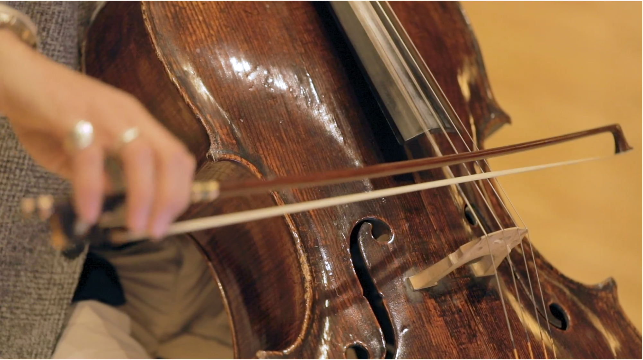

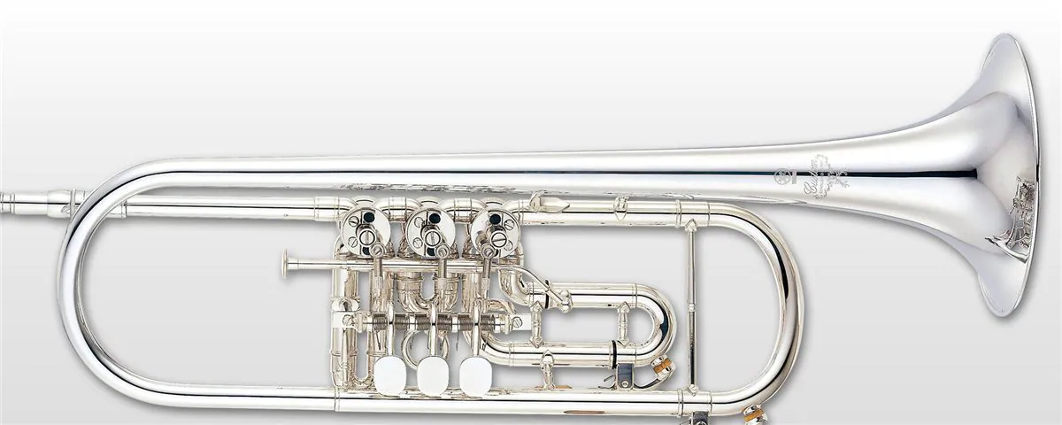

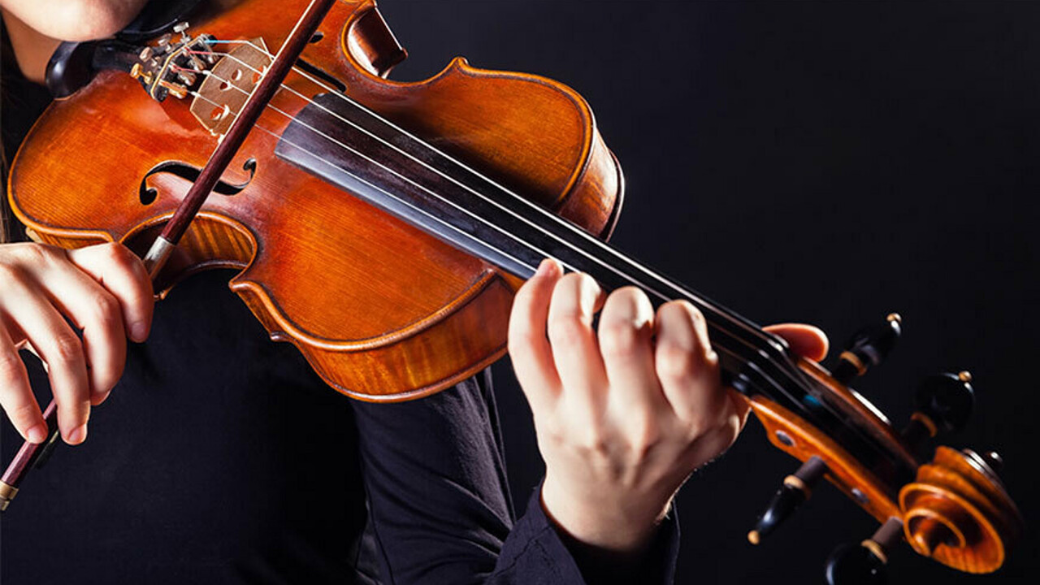

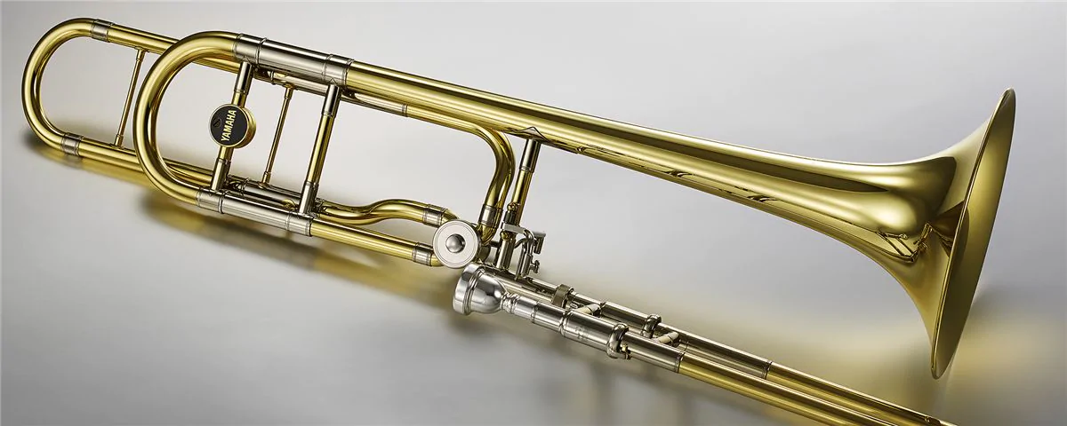

ISPR - MIDTERM 1 - ASSIGNMENT 3
Cello
Largest violin after contrabassoon. Played on the ground. Low sound.
ANALYSED
INSTRUMENTS
TWO INSTRUMENTS FOR TWO “FAMILIES”
Trumpet
Small brass instrument equipped with keys.
Sound range is quite high..
Violin family (strings)
Sound waves are produced by a bow rubbing strings.
a
Brass family (wind)
Different pitches are produced using slides, keys and crooks.
b
Violin
The smallest of its family. It’s played on the shoulder. Sound is high..
Trumpet and violin are expected to produce higher sound with respect to cello and trombone, whose pitch is considerable lower.
So similarity may be detected both between instruments belonging the same family rather than ones closer in terms of sound height.
When plotting spectrograms, each column will correspond to an instrument: (1) Cello, (2) Violin, (3) Trombone, (4) Trumpet.
Trombone
Equipped with a large sliding coulisse.
Several sizes exist, with generally middle-low sound.

Slide 3
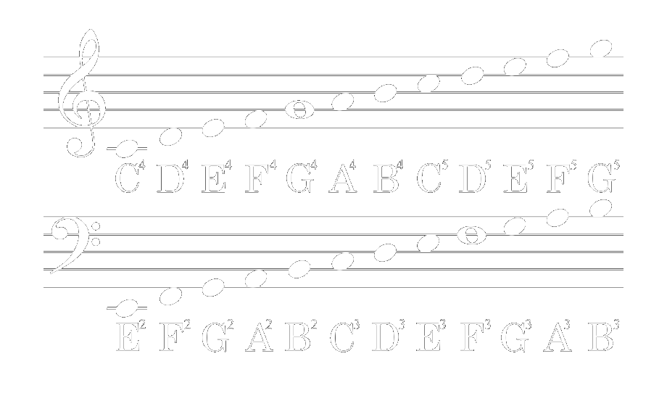




ISPR - MIDTERM 1 - ASSIGNMENT 3
CHOSEN NOTE SETS
ISOLATE VARIATING FACTORS (DYNAMIC & HEIGHT)
A huge constraint was the non strict regularity in the dataset: basing on note ids, not every dynamic was present for each note.
For arc instruments, only “arco normal” played notes were picked to avoid introducing another source of complexity.
Each set aims to expose how different aspects impacts on waves and spectrum .
{A3_1, B4_025,G5_15}
{C4_1, C5_1, C6_1}
{B4_05} X {pp,f,ff}
23%
Different octaves
Same dynamic and note
Different dynamics
Same note
Random notes
Same dynamic

Slide 4

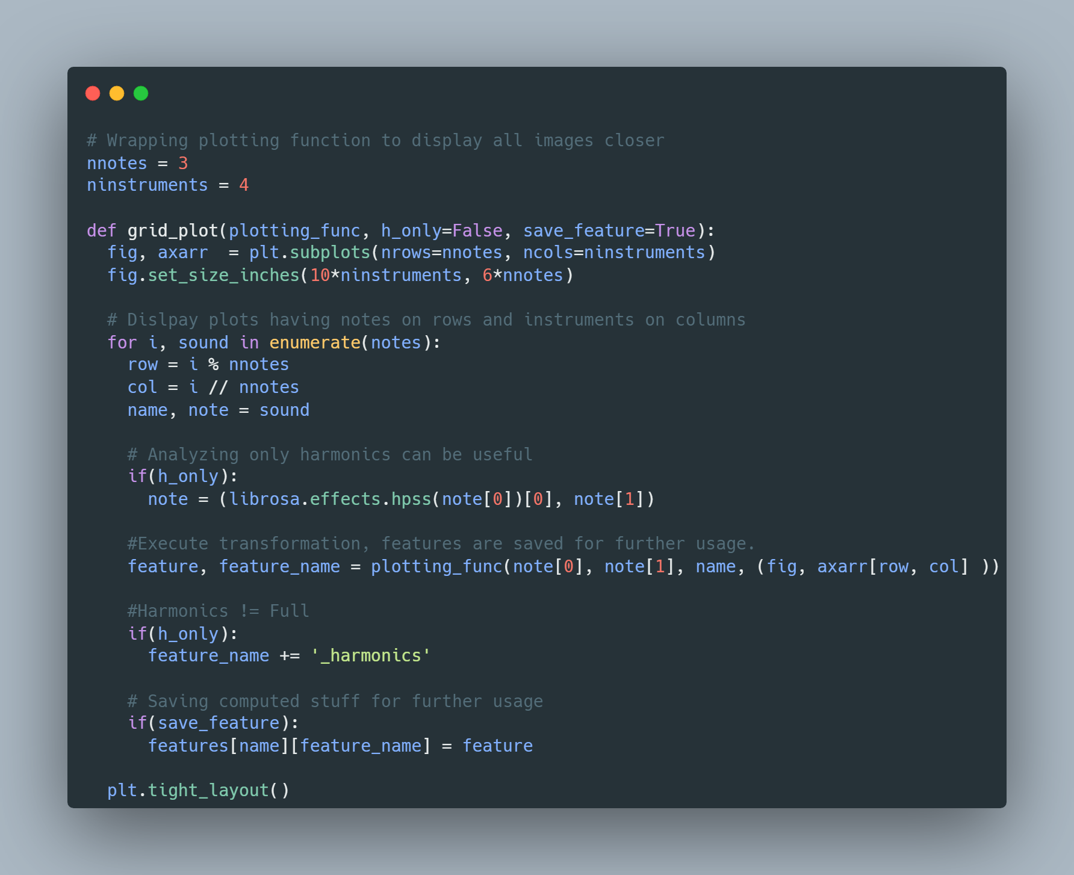
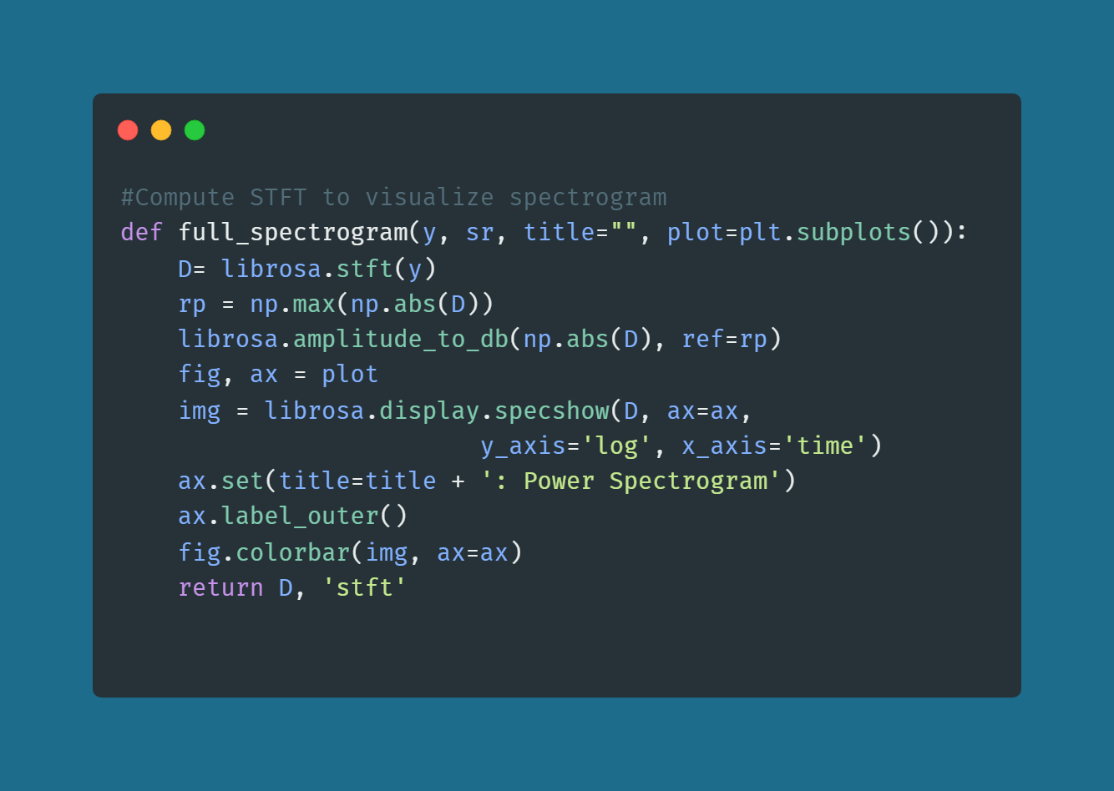

ISPR - MIDTERM 1 - ASSIGNMENT 3
ABOUT METHOD AND CODE
Librosa and matplotlib are the hinges of this experimentation.
Documentation examples were followed to implement a the various plotting functions considerable useful for the analysis.
A global high order function was implemented to display subplots in a grid and make observation easier.
Harmonics isolation was also implemented ,as an option, within this function, allowing visualize difference with respect to the full spectrum.
The full notebook can be viewed just by clicking on the Colab Icon in this slide.
Preprocessing
All considered notes were uploaded on a new Google Drive folder and loaded into the Colab Notebook using librosa.load function.
Each extracted time-series was then trimmed, applying again a librosa function to delete “silence” moment (according to a predetermined threshold).

Slide 5





ISPR - MIDTERM 1 - ASSIGNMENT 3
COMPUTATION: STFT
librosa compute spectrograms using the Short Time (Discrete) Fourier Transform.
The STFT represents a signal in the time-frequency domain by computing discrete Fourier transforms (DFT) over short overlapping windows.
The number of rows in the STFT matrix D is (1 + n_fft/2). The default value, n_fft=2048 samples, corresponds to a physical duration of 93 milliseconds at a sample rate of 22050 Hz, i.e. the default sample rate in librosa.
Theoretical foundation
There is no significant information lost if we replace the short term spectrum X(f, t) with its sampled version Xnm by sampling it at the two Nyquist periods 1/F and 1/T.
Jont B. Allen (June 1977). "Short Time Spectral Analysis, Synthesis, and Modification by Discrete Fourier Transform". IEEE Transactions on Acoustics, Speech, and Signal Processing. ASSP-25 (3): 235–238.
1

Slide 6
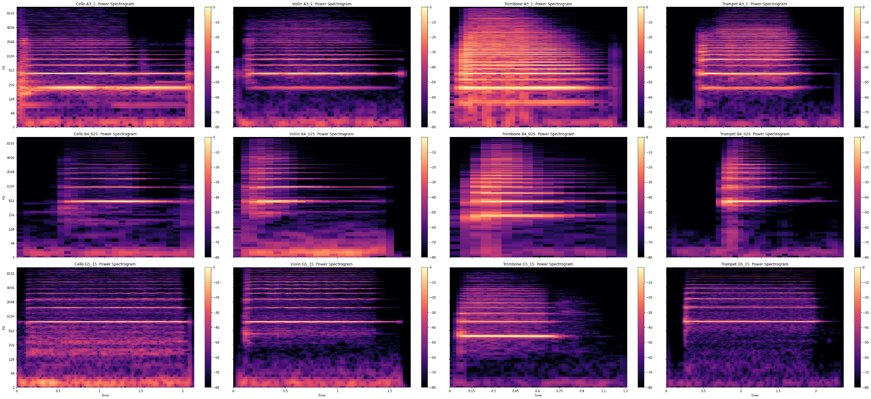
ISPR - MIDTERM 1 - ASSIGNMENT 3
FULL POWER SPECTROGRAM
45%
Online transaction
Proactively brand corporate technology. Dramatically incubate multimedia based.
“One-sheet fire up your browser golden goose, or prairie doggig so come up with something buzzworthy.”

Slide 7




ISPR - MIDTERM 1 - ASSIGNMENT 3
COMPUTATION: HARMONICS EXTRACTION
Minimization the L2 norm of the power spectrogram gradients allows, formally, to achieve separation.
Median filters operates replacing a given sample in a signal by the median of the signal values in a window around the sample, smoothing both the percussive and harmonics components. .
Intuition behind
This technique was based on the idea that stable harmonic or stationary components form horizontal ridges on the spectrogram, while percussive components form vertical ridges with a broadband frequency response.
1
Driedger, Müller, Disch. “Extending harmonic-percussive separation of audio.” 15th International Society for Music Information Retrieval Conference (ISMIR 2014), Taipei, Taiwan, 2014.
2

Slide 8
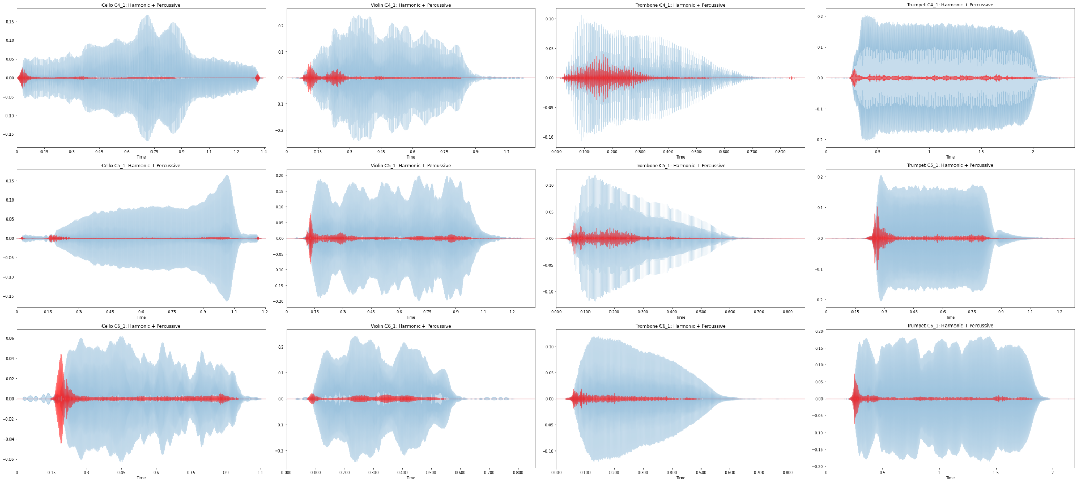
ISPR - MIDTERM 1 - ASSIGNMENT 3
HARMONICS PERCUSSIVE DECOMPOSITION
45%
Online transaction
Proactively brand corporate technology. Dramatically incubate multimedia based.
“One-sheet fire up your browser golden goose, or prairie doggig so come up with something buzzworthy.”

Slide 9
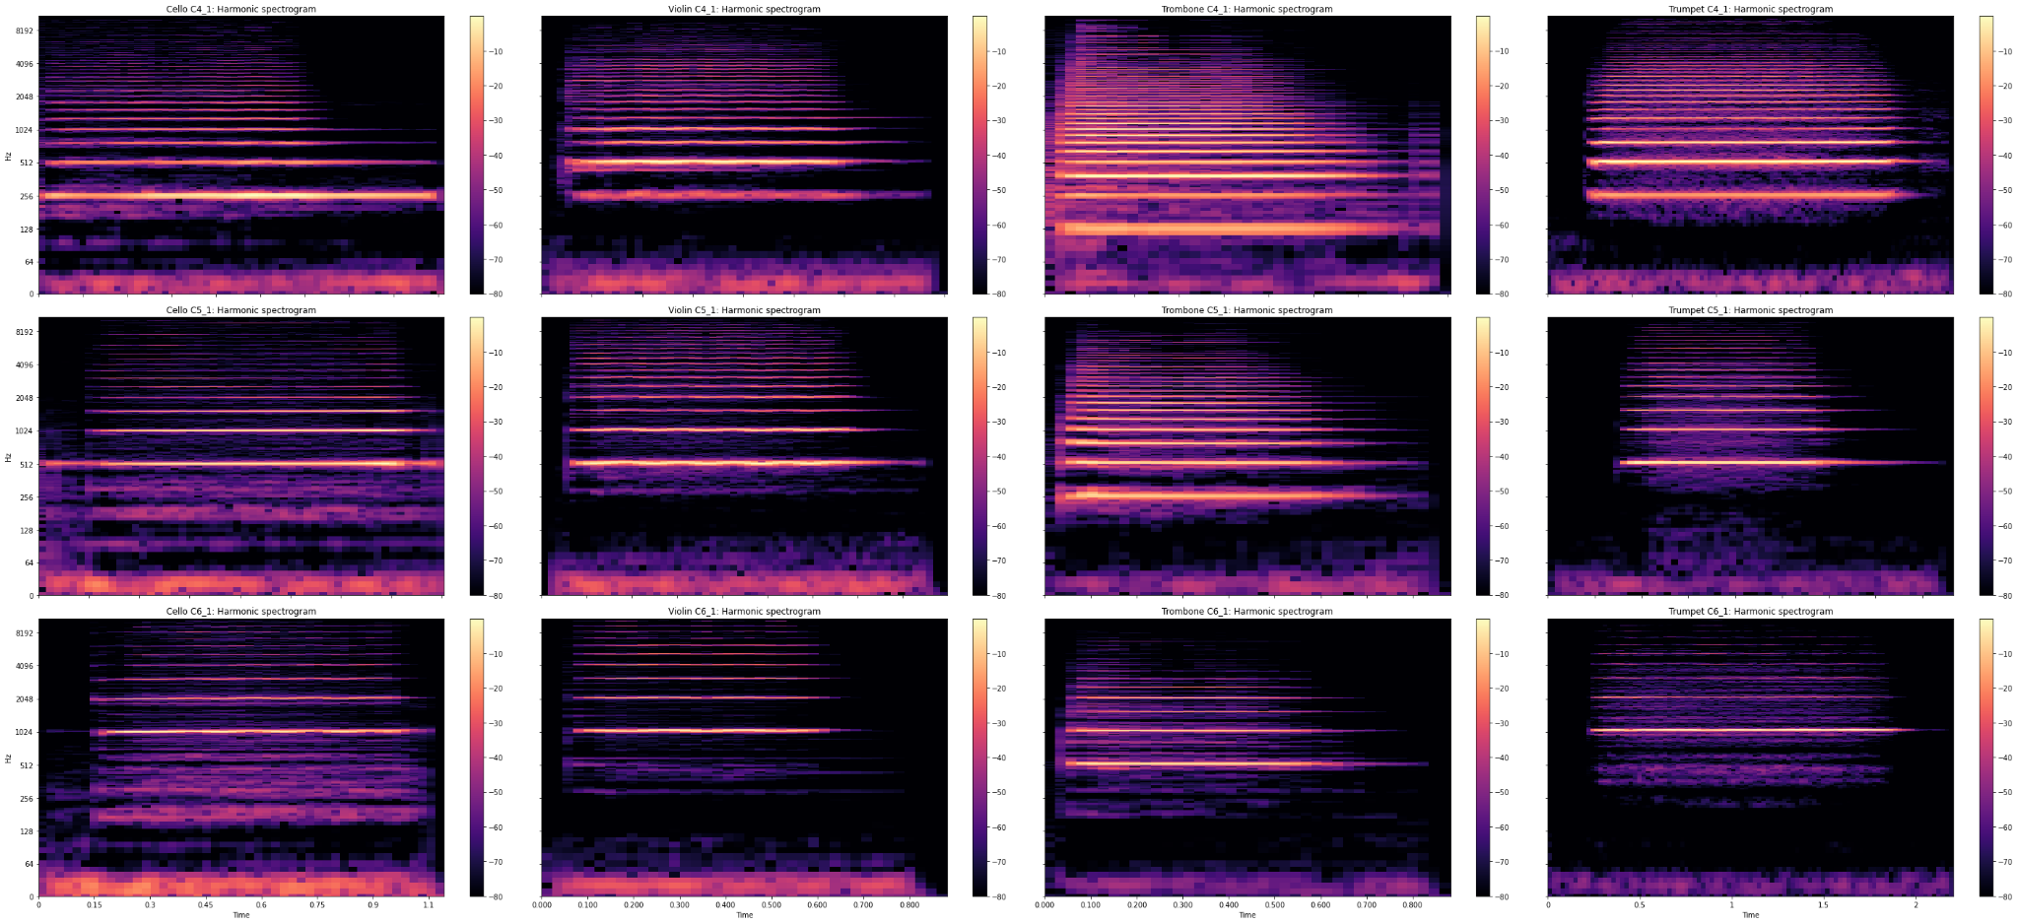
ISPR - MIDTERM 1 - ASSIGNMENT 3
HARMONICS: SIMILAR SPECTROGRAMS
45%
Online transaction
Proactively brand corporate technology. Dramatically incubate multimedia based.
“One-sheet fire up your browser golden goose, or prairie doggig so come up with something buzzworthy.”

Slide 10
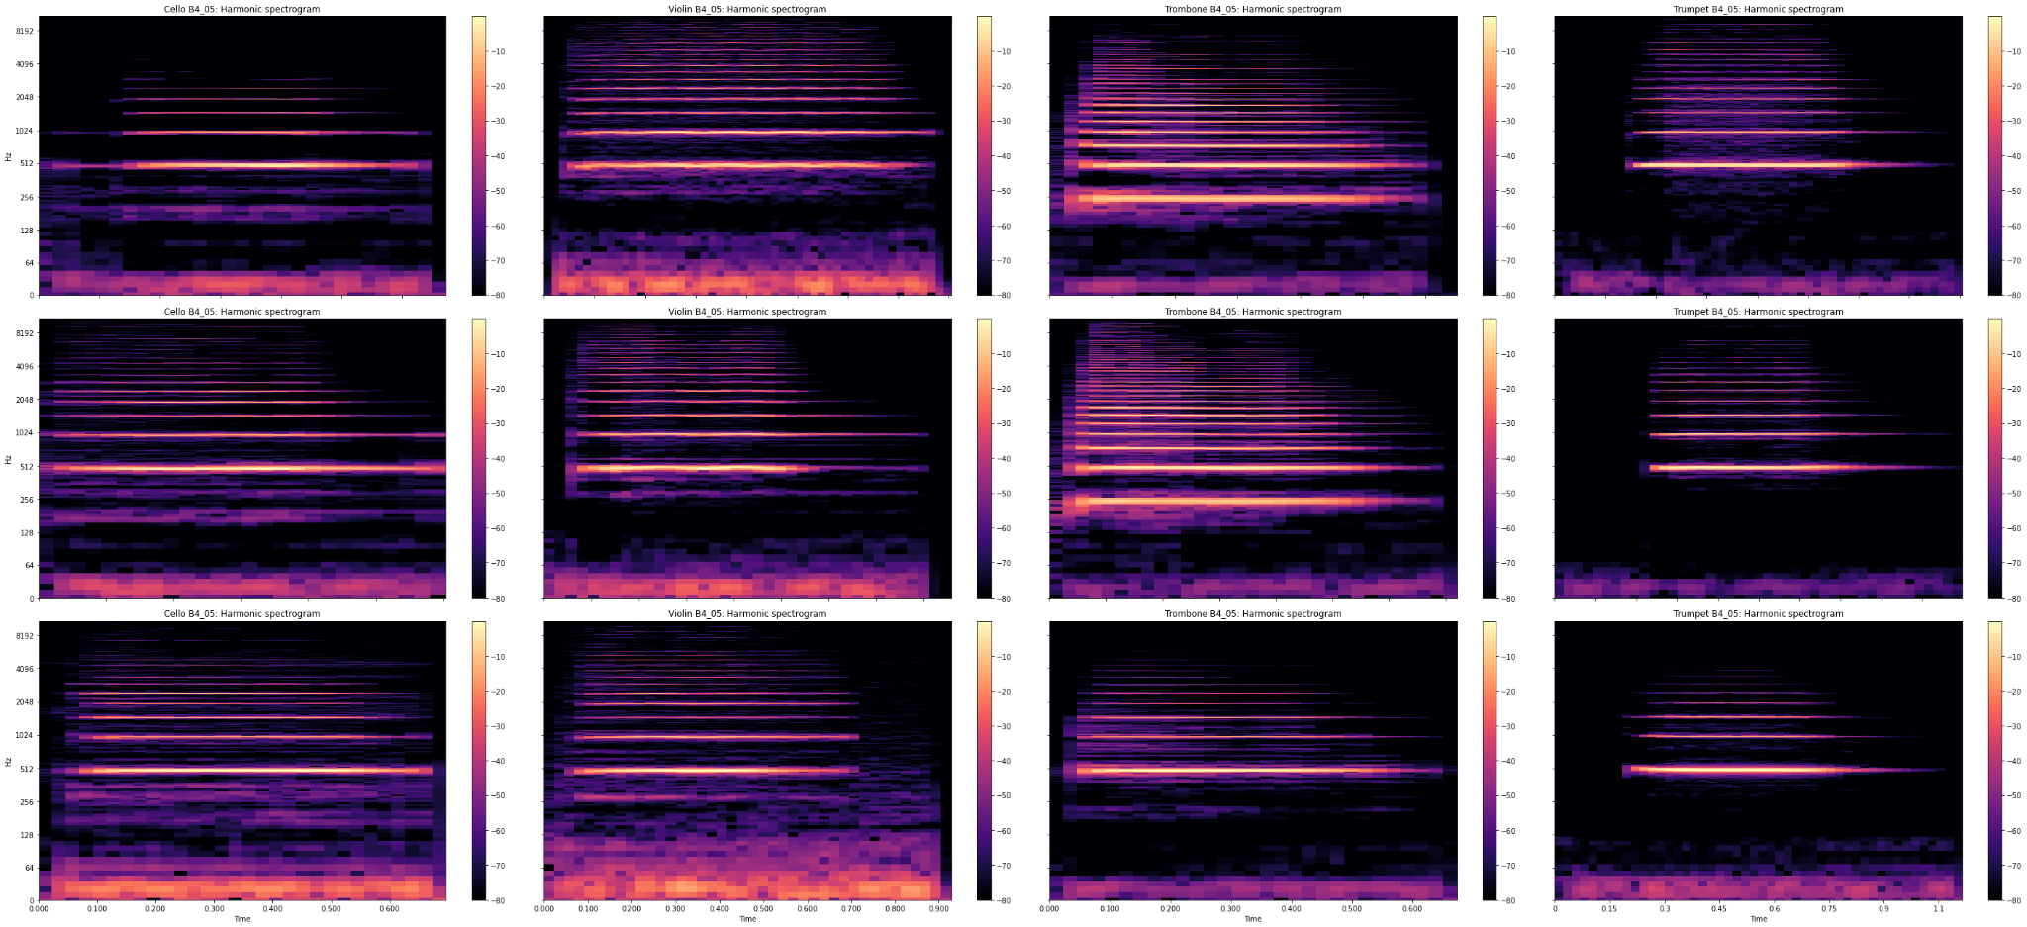
ISPR - MIDTERM 1 - ASSIGNMENT 3
HARMONICS: SIMILAR SPECTROGRAMS
45%
Online transaction
Proactively brand corporate technology. Dramatically incubate multimedia based.
“One-sheet fire up your browser golden goose, or prairie doggig so come up with something buzzworthy.”

Slide 11
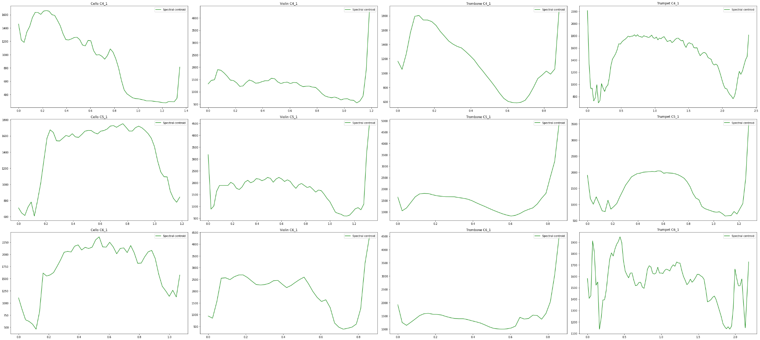
ISPR - MIDTERM 1 - ASSIGNMENT 3
HARMONICS: SPECTRAL CENTROIDS
45%
Online transaction
Proactively brand corporate technology. Dramatically incubate multimedia based.
“One-sheet fire up your browser golden goose, or prairie doggig so come up with something buzzworthy.”

Slide 12
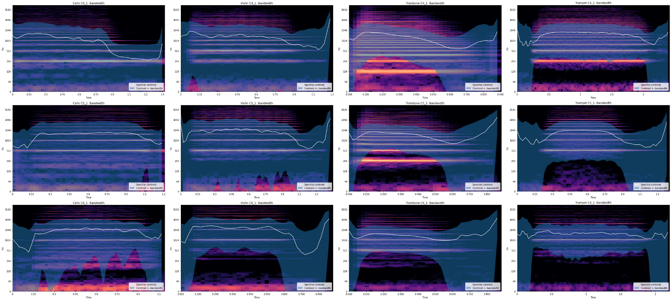
ISPR - MIDTERM 1 - ASSIGNMENT 3
BANDWIDTH AND CENTROIDS
Online transaction
Proactively brand corporate technology. Dramatically incubate multimedia based.
“One-sheet fire up your browser golden goose, or prairie doggig so come up with something buzzworthy.”

Slide 13
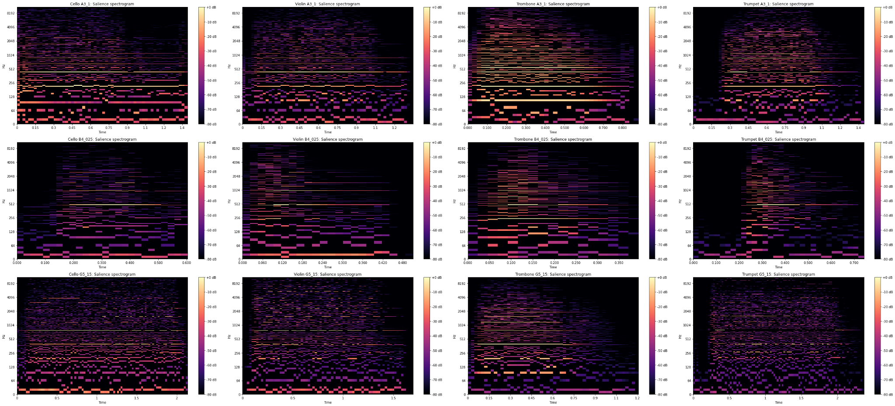
ISPR - MIDTERM 1 - ASSIGNMENT 3
VISUALIZATION: SALIENCE SPECTROGRAM
45%
Online transaction
Proactively brand corporate technology. Dramatically incubate multimedia based.
“One-sheet fire up your browser golden goose, or prairie doggig so come up with something buzzworthy.”

Slide 14



ISPR - MIDTERM 1 - ASSIGNMENT 3
Theoretical deepening
Concept clarified reading papers and experimenting their direct application.
FINAL CONSIDERATION
ABOUT INSTRUMENT PITCH RECOGNITION
New skills as a developer
Experience with librosa and matplotlib for time-series and spectrograms.
Each instrument shown a different harmonic profile. Instrument within the same family have closer profiles.
Fixing a note helped a lot reducing complexing, highlighting key similarities and differences.
Octave change produced a vertical translation of the harmonic profile, following the logarithmic scale.
Dynamic variation was translated into a (proportional) decreasement of energy level for the various harmonics, making spectre of various note similar even if played by different instruments.
Advanced tools explored
STFT, HPPS decomposition, spectral centroids and bandwidth, salience and more…
FURTHER “WEIRD” IMPROVEMENTS
Several ideas occurred while performing the assignment, like the creation of simplified feature (mean, std, min, max etc..) from computed spectrograms and representation, allowing to computes simple DM algorithms like K-means or even PCA on note-vectors.
Papers on MIR using CNN already exist, maybe they would be useful for the Deep Learning assignment.
ABOUT THE ASSIGNMENT

